Slide 1
Telco Customer Churn Predictions with Logistic Regression, XGBoost Classifier & Random Forest Classifier
By
Marcel Ngwueke
Springboard Data Science Career Track, May 2021 cohort Capstone 3 Project

Slide 2
Table of Contents
Problem Statement
Business Definition
Business Objective
Data Source
Data Cleaning & Manipulation
Exploratory Data Analysis (EDA)
Logistic Regression Model
XGBoost Classifier Model
Random Forest Classifier Model
Model Assessments
Conclusion
Recommendations

Slide 3
Problem Statement
Business Definition:
How good is the telco product market fit(PMF) as indicated by retention rate?
Can churn prediction techniques identify possible customers that want to leave?
Any retention strategies to diminish prospective
customer churn based on the model output?
Business Objective:
Determine the exact number of churns with best Algorithm and best ML model.

Slide 4
Data Source and Structures
Data Source:
https://www.kaggle.com/blastchar/telco-customer-churn
Number of rows: 7043 and Number of Columns: 21
These are composed of numerical and categorical variables.
Data types:
Has 18 objects, 1 float and 2 integers.

Slide 5
Data Cleaning and Manipulation
Checking for missing values or NaN
The column ‘TotalCharges’ was converted to numeric and as a float data type
Missing values of ‘TotalCharges’ were filled with column mean value
Sklearn.preprocessing. LabelEncoder converts categorical variables to numerical variables for Machine Learning algorithms to handle.

Slide 6
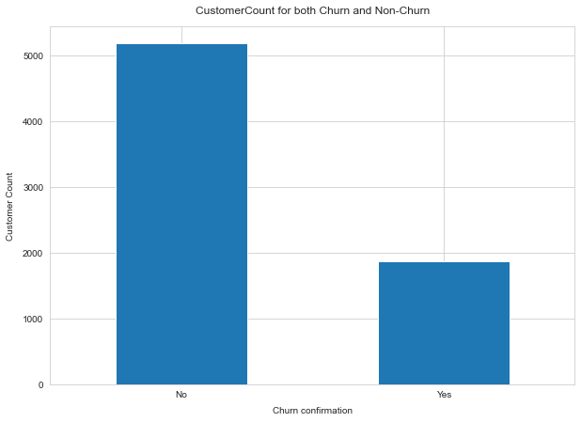
Exploratory Data Analysis (EDA)
Visual representation of Target Variable – CHURN:
Non-Churn customers = 5174 and Churn customers = 1869

Slide 7
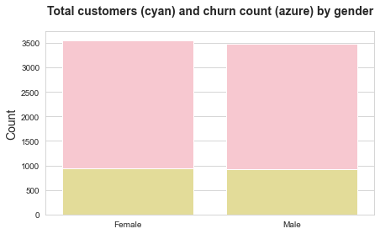
EDA [contd.]
Distribution of gender attribute
Whether female or male does not influence the churn

Slide 8
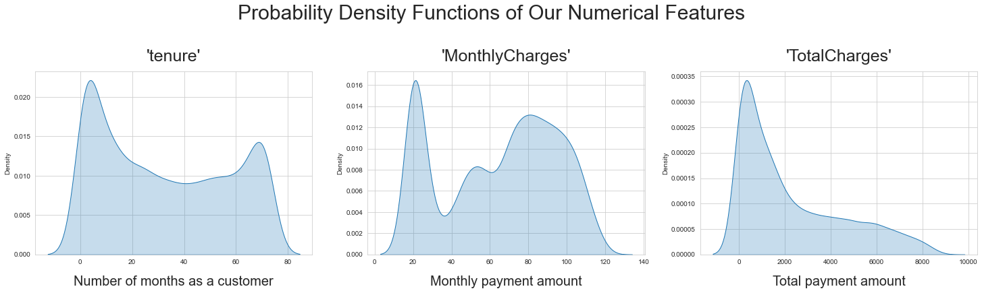
EDA [contd.]
Probability Density of the Numerical Variables
Tenure is bimodal(new or old subscribers)
MonthlyCharges-bimodal( <36 dollars or close to $70)
TotalCharges occurs either <1000 0r above $4000.

Slide 9
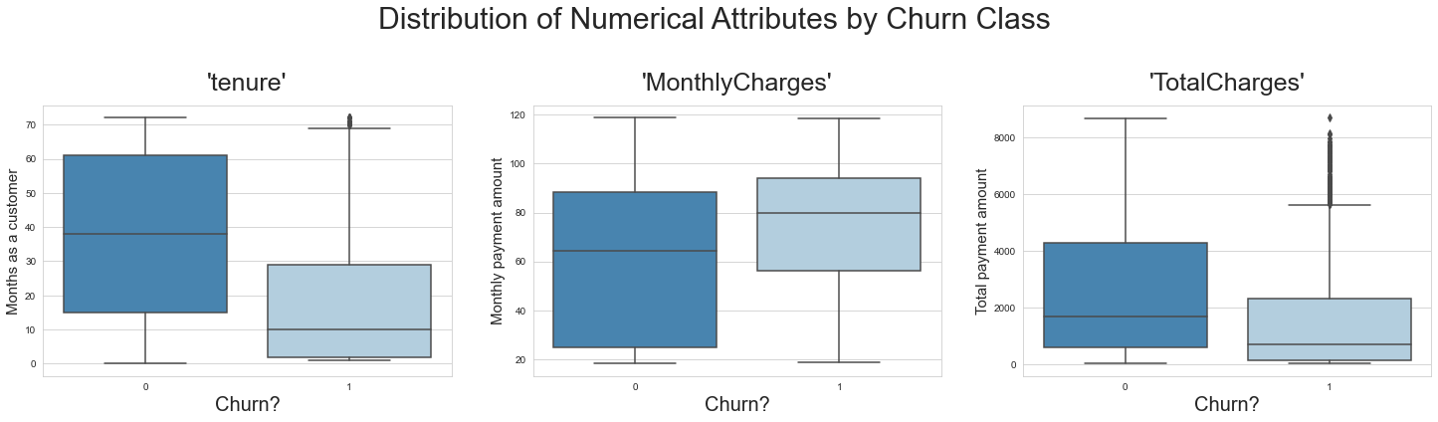
EDA [contd.]
Numerical variables by churn class
Tenure – new customers tend to churn
MonthlyCharges-monthly payees tends to churn
TotalCharges – customers paying less tend to churn

Slide 10
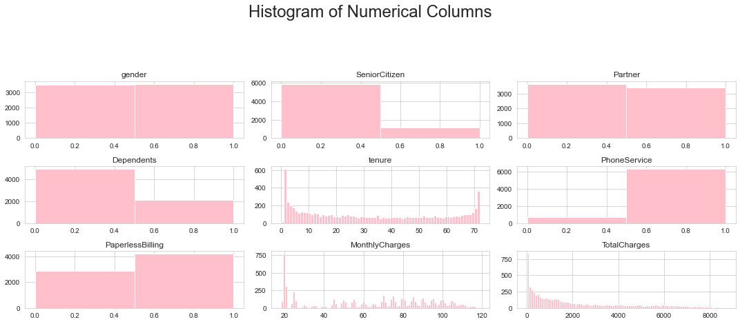
EDA [contd.]
Same distribution for both Male and Female
Tenure shows new customers and very loyal customers

Slide 11
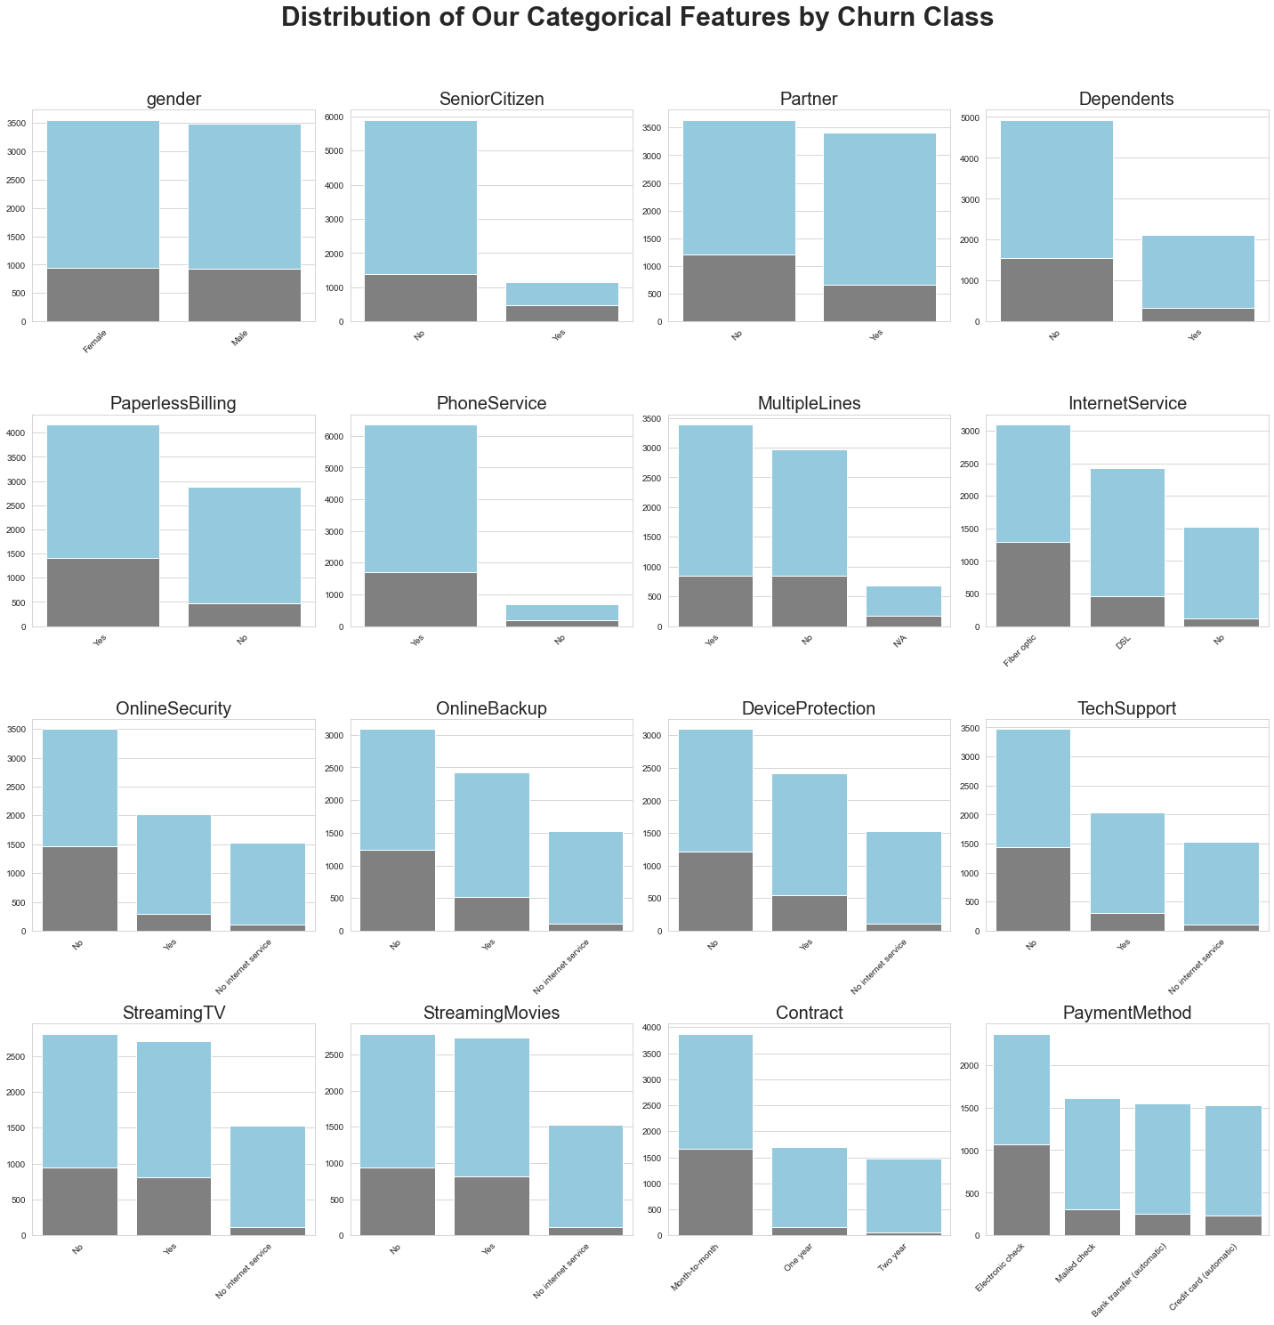
EDA [contd.]

Slide 12
Logistic Regression Algorithm
Identify Churn as Target, Other Features as Non-Target
Split dataset for Training
Instantiate Logistic Regression with following params: fit_intercept = False, C = 1e13, solver = ‘liblinear’
Perform fit and predict operations
Results include: Accuracy: 0.72, Precision:0.489, Recall:0.869, F1 score: 0.623, F2 score:0.751
Same distribution for both Male and Female
Tenure shows new customers and very loyal customers

Slide 13
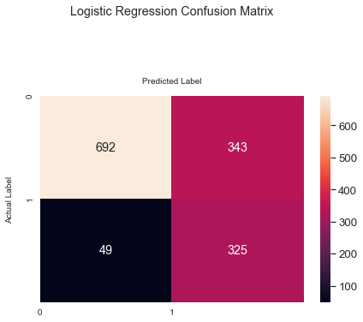
Logistic Regression [contd]
Confusion Matrix based on the above params
Correct prediction(692+325) Incorrect Prediction(49+343)
Same distribution for both Male and Female
Tenure shows new customers and very loyal customers

Slide 14
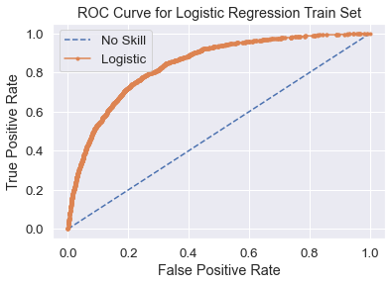
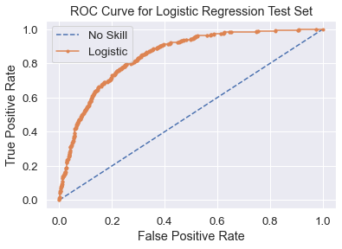
Logistic Regression [contd.]
ROC AUC = 0.841 for Train data set
ROC AUC for Test datasets
ROC AUC = 0.847

Slide 15
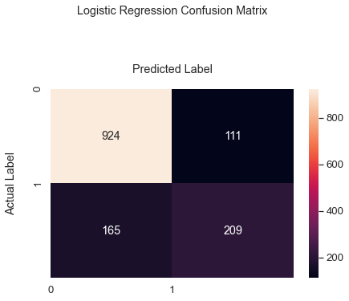
Logistic Regression [contd.]
Hyperparameter Tuning Logistic
Regression
C = 0.01, penalty = 12, solver = liblinear
Predictions and Prediction Probability were obtained.
Confusion Matrix resulted in 0.8041 for Test Accuracy
ROC AUC = 0.847
Correct prediction(924+209)
Incorrect prediction(165 +111)

Slide 16
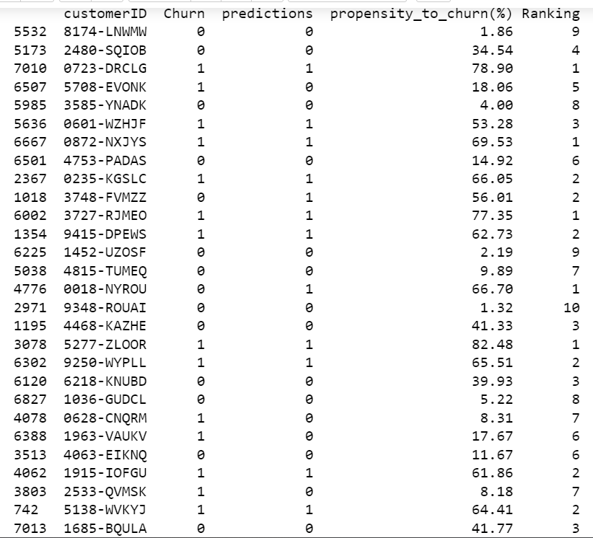
Logistic Regression [contd.]
Table showing Predictions, Propensity to churn, and Ranking

Slide 17
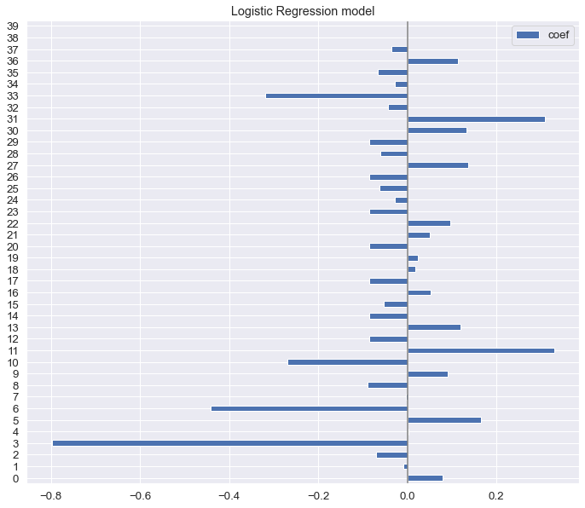
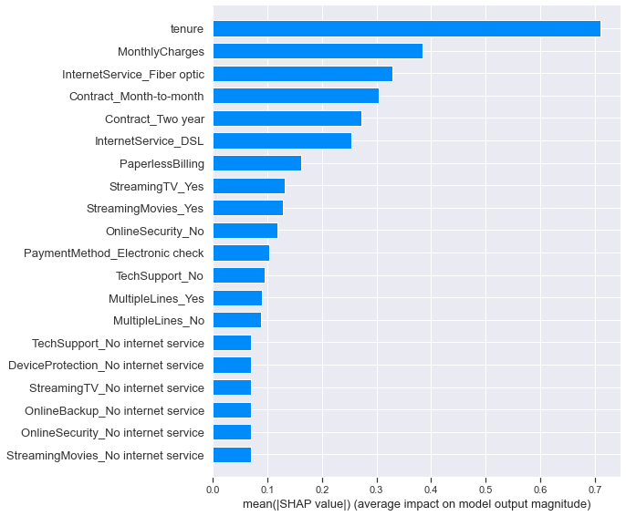
Logistic Regression [contd.]
Shap summary plot
ROC AUC = 0.847
Feature Importance

Slide 18
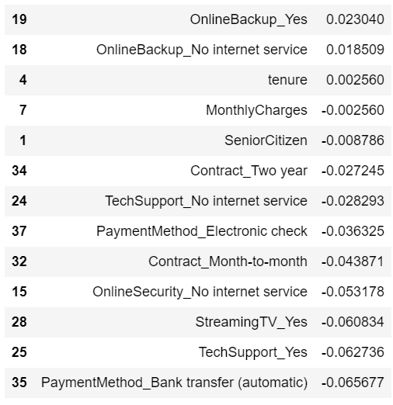
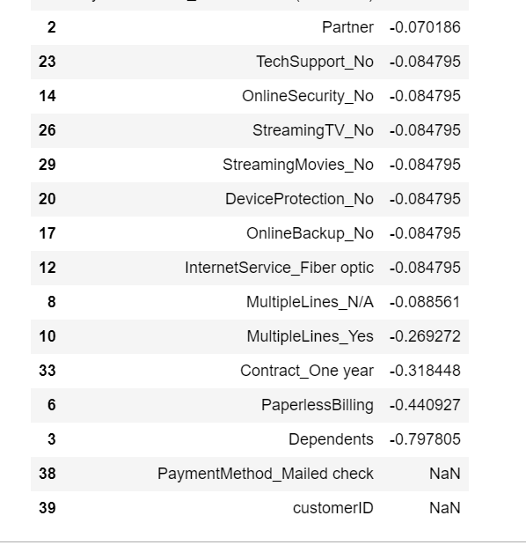
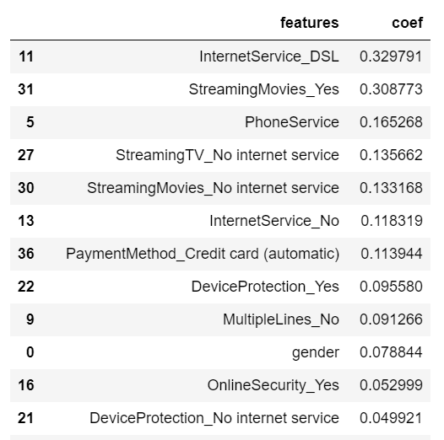
Logistic Regression [contd.]
Corresponding Feature names:
y

Slide 19
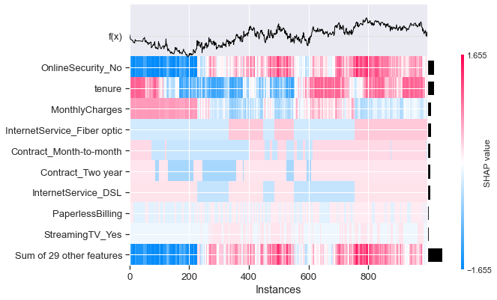
Logistic Regression [contd.]
Shap heatmap of the model features.

Slide 20
XGBoost Classifier
Instantiate Extreme Gradient Boosting Classifier with the following params: objective: binary-logistic, missing =1, seed = 42
Perform fit and predict on the training dataset.
Results show:- Accuracy=0.799, Precision=0.660, Recall = 0.503, F1 score = 0.571, F2 score = 0.528

Slide 21
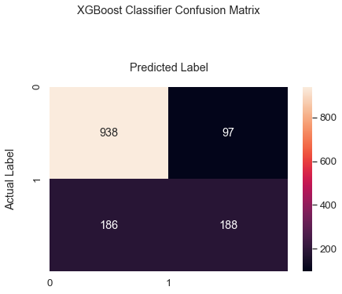
XGBoost Classifier [contd]
Confusion Matrix based on the above params
Correct prediction(938+188) Incorrect Prediction(186+97)
Same distribution for both Male and Female
Tenure shows new customers and very loyal customers

Slide 22
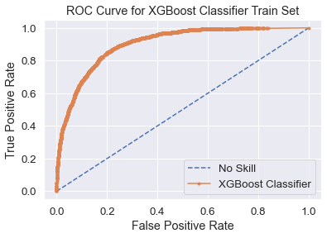
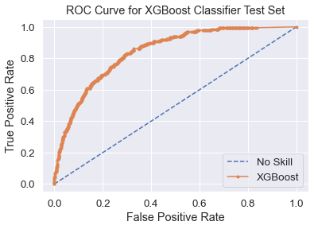
XGBoost Classifier [contd.]
ROC AUC for Test datasets
ROC AUC = 0.841
ROC AUC = 0.901 for Train data set

Slide 23
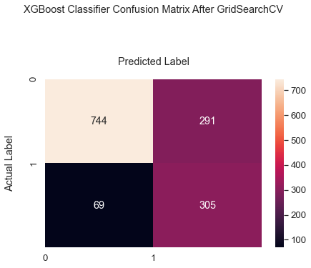
XGBoost Classifer [contd.]
GridSearchCV Hyperparameter Tuning of XGBoost Classifier
Max depth, Learning rate, gamma, n jobs, cv = 3
Predictions and Prediction Probability were derived.
Confusion Matrix resulted in 0.7445 for Test Accuracy
ROC AUC = 0.847
Correct prediction(744+305)
Incorrect prediction(69+291)

Slide 24
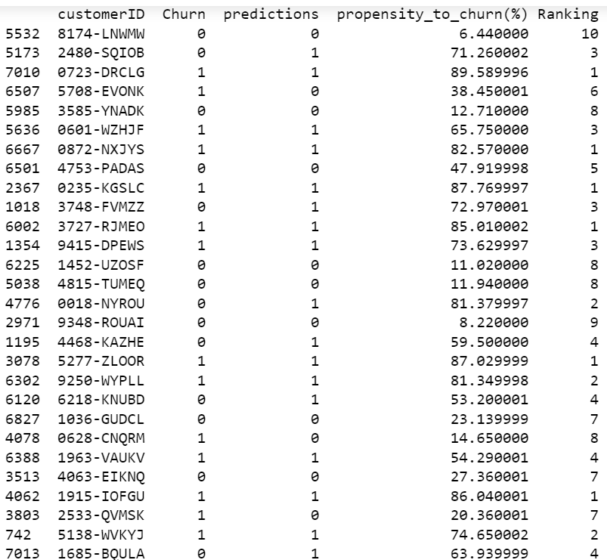
XGBoost Classifier [contd.]
Table showing Predictions, Propensity to churn, and Ranking

Slide 25
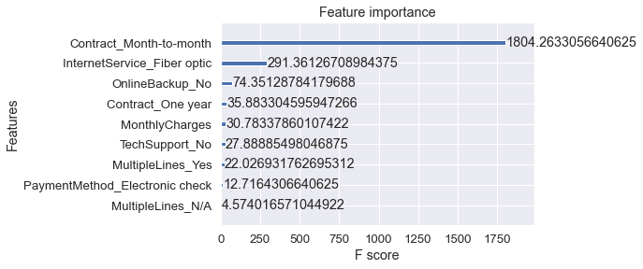
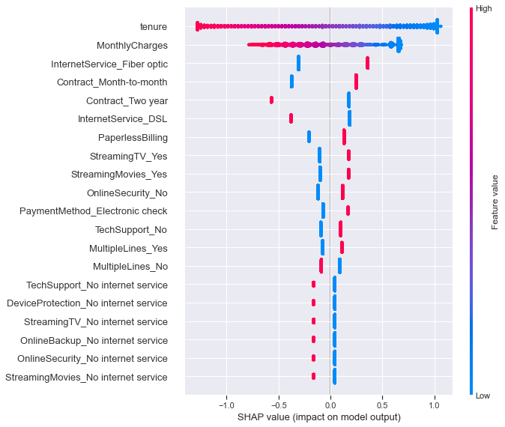
XGBoost Classifier [contd.]
Shap summary plot
ROC AUC = 0.847
Feature Importance

Slide 26
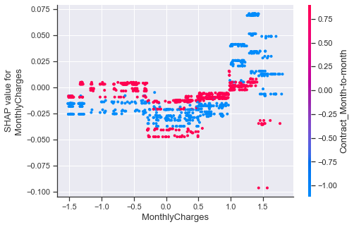
XGBoost Classifier [contd.]
Shap dependence plot of the model MonthlyCharges.

Slide 27
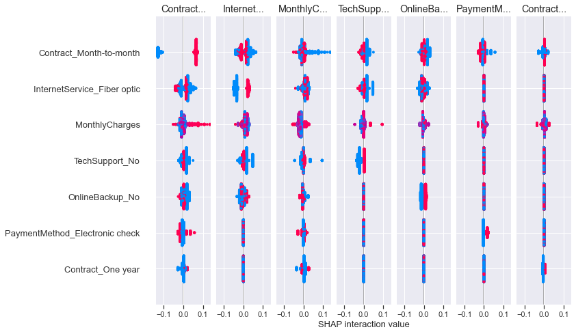
XGBoost Classifier [contd.]
Shap Interaction values based on the test set.

Slide 28
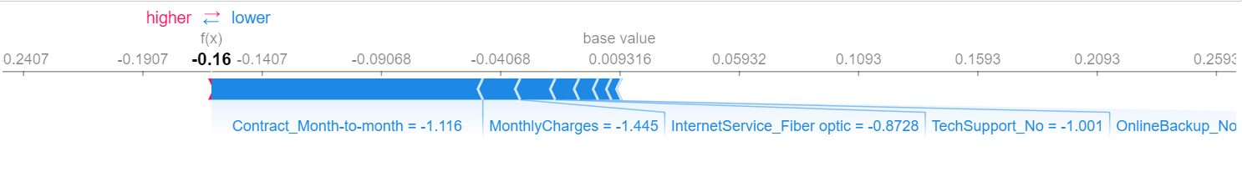
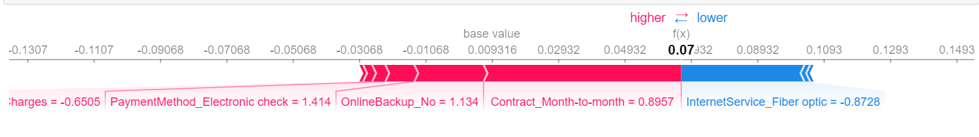
XGBoost Classifier [contd.]
Shap plots force for index zero. Blue shows non-contributory features
Shap plots force for index one. Red features are contributory

Slide 29
Random Forest Classifier
Instantiate Random Forest Classifier
Perform fit and predict operation on the training set
Result shows training set Accuracy of 0.996 and Test set Accuracy of 0.776
Results show:- Accuracy=0.799, Precision=0.6014, Recall = 0.4519, F1 score = 0.516, F2 score = 0.4755
Cross Val Score was 0.78 +/-0.03

Slide 30
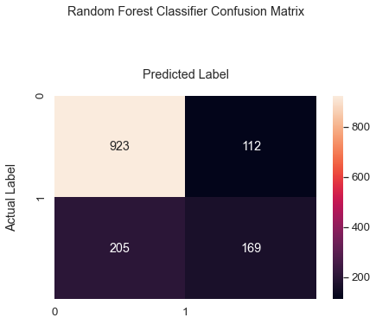
Random Forest Classifier[contd.]
Confusion Matrix based on the above Model
Correct prediction(923+169) Incorrect Prediction(205+112)
Same distribution for both Male and Female
Tenure shows new customers and very loyal customers

Slide 31
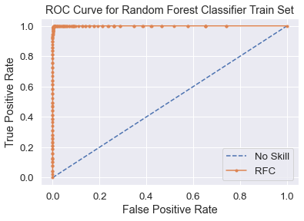
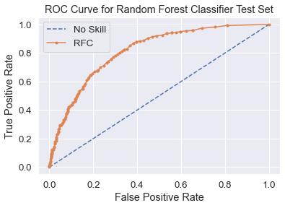
Random Forest Classifier [contd.]
ROC AUC for Test datasets
ROC AUC = 0.814
ROC AUC = 1.00 for Train data set

Slide 32
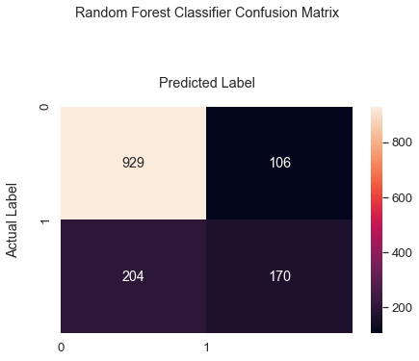
Random Forest Classifer [contd.]
GridSearchCV Hyperparameter Tuning of Random Forest Classifier
With some params and cv = 5
Predictions and Prediction Probability were derived using this tuned model
Confusion Matrix resulted in 0.780 for Test Accuracy
ROC AUC = 0.847
Correct prediction(929+170)
Incorrect prediction(204+106)

Slide 33
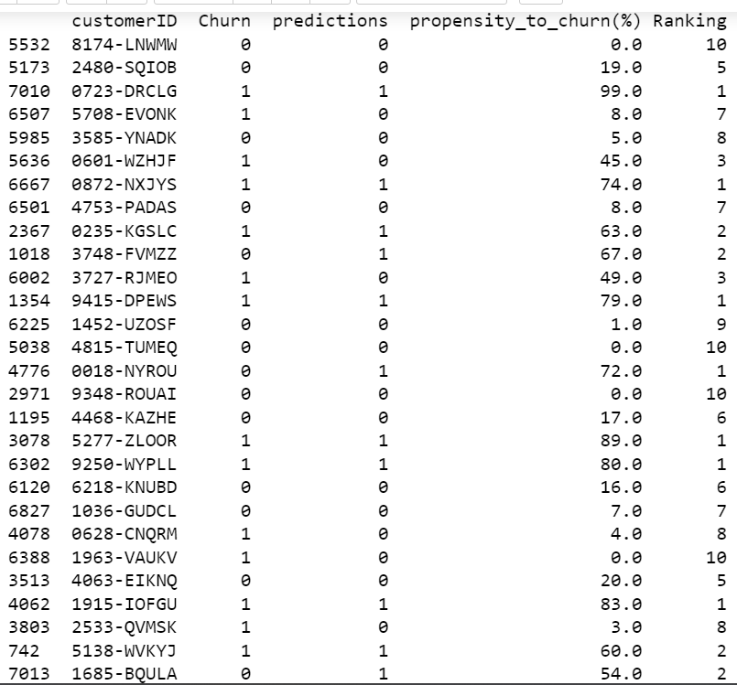
Random Forest Classifier [contd.]
Table showing Predictions, Propensity to churn, and Ranking

Slide 34
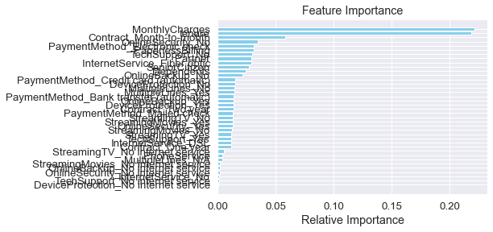
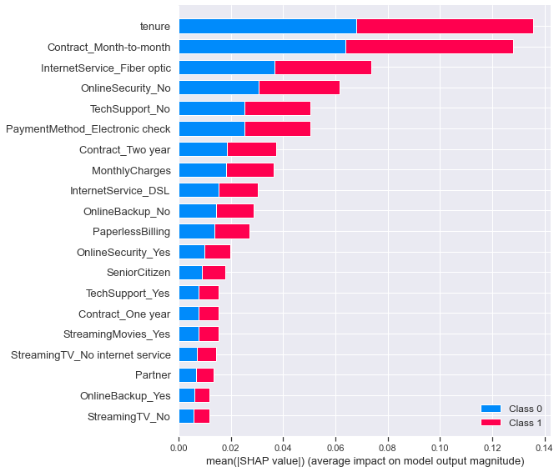
Random Forest Classifier [contd.]
Shap summary plot
ROC AUC = 0.847
Feature Importance

Slide 35
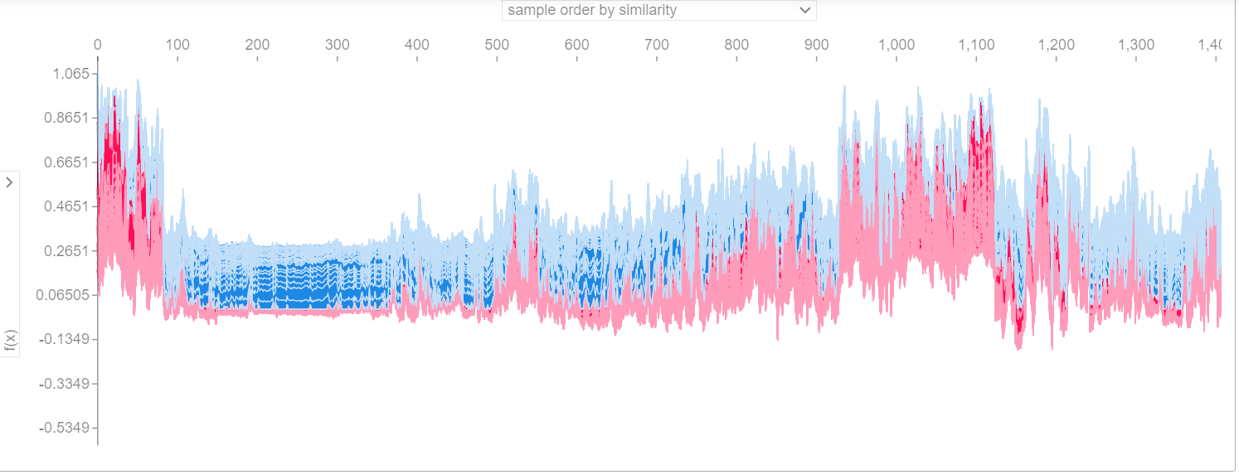
Random Forest Classifier [contd.]
Shap Force plot for RFC model
Force plot is based on sample order by similarity

Slide 36
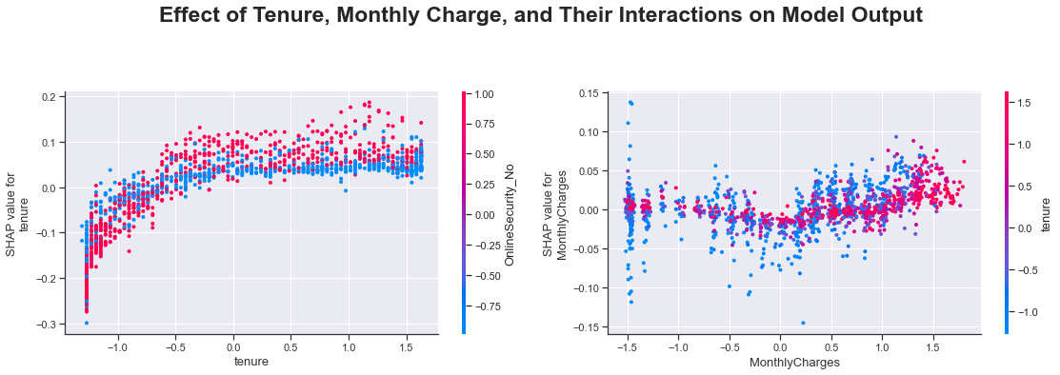
Random Forest Classifier [contd.]
Effect of tenure, monthly charges and their interactions on model output
Tenure interacts with online security no, monthly charges with tenure.

Slide 37
Model Assessment
Table showing how the Algorithms stand
Model | ROC AUC | Train Accuracy | Test accuracy | Precision | Recall | F1 Score | F2 Score
XGBC | 0.901/0.876 | 0.841 | 0.876 | 0.660 | 0.503 | 0.571 | 0.528
LR | 0.841/0.847 | 0.752 | 0.804 | 0.487 | 0.867 | 0.624 | 0.751
RFC | 1.00/0.816 | 0.996 | 0.775 | 0.601 | 0.452 | 0.516 | 0.476

Slide 38
CONCLUSION
Three Machine learning Algorithms were used.
Logistic Regression, XGBoost Classifier and
Random Forest Classifier
XGBoost Classifier: ROC AUC = 0.876
Logistic Regression: ROC AUC = 0.841
Random Forest Classifier: ROC AUC = 0.816.
Random Forest Classifier demonstrated training
set accuracy of 0.997, and test set accuracy of
0.781, and a cross val score of 0.79 +/- 0.03; and
the ROC AUC for the test set was 0.816 and
1.00 for the training set.

Slide 39
Recommendations
XGBoost Classifier out-performed other models.
The organization customer retention group is presented with this model to restrategize their business program
With this customers with high propensity to churn are targeted.
Following up with incentives bonuses to help the company to enjoy increased revenues via improved retention program or strategy.

Slide 40
Thank you.

